Slide 1
Functional LITERACY
Stacy A. Griffin, Ed.D.
Wendy A. McWhorter, M.A.
Educators, Researchers, and Consultants

Slide 2
Agenda
Opening Activity
Overview of Functional Literacy
Research Based Principles
    Strategy
    Assessment
    Teaching
    Activity
    Implications
Closure

Slide 3
Opening Activity: One Word
Think for a minute about your struggling readers
Decide on one word to describe your struggling readers
Share your word and why you chose the word you did
Discuss the word with your group
  Does the word resonate?
  Share personal stories
Notes:
Share whole group.
Follow up questions to whole group:
What is your experience with struggling readers?
How does your instructional situation affect how you are able to currently address the needs of struggling readers?
What are some of your concerns addressing the needs of struggling readers?

Slide 4
Objectives
By the end of this workshop participants will be able to…
    Discuss functional literacy
    Define the four research-based principles
    Articulate how functional literacy can influence teaching and learning
Notes:
Reciprocity between reading and writing

Slide 5
Functional Literacy
A term initially defined for UNESCO by William S. Gray (The Teaching of Reading and Writing, 1956, p. 21) as the training of adults to 'meet independently the reading and writing demands placed on them'.
Notes:
The definition employed by the UNESCO Institute for Statistics sees functional literacy as a level of reading, writing, and calculation skills sufficient to function in the particular community in which an individual lives.Feb 23, 2011

Slide 6
The Statistics
3 out of 5 people in American prisons can’t read
Over 60% of adults in the US prison system read at or below the fourth grade level
Two-thirds of students who cannot read proficiently by the fourth grade will end up in jail or on welfare
85% of US juvenile inmates are functionally illiterate
To determine how many prison beds will be needed in future years, some states actually base part of their projection on how well current elementary students are performing on reading tests
National Center for Educational Statistics in the United States
National Institute for Literacy, National Center for Adult Literacy, The Literacy Company, U.S. Census Bureau
Notes:
Let’s talk about your experience.

Slide 7
Motivation
“When researchers have looked at motivation, results suggest that dealing with adults literacy beliefs and goals for learning may increase their reading comprehension achievement (95).”
(Curtis & Kruidenier, 2005)
What are motivating factors for your adult learners ?
Notes:
Chat and chart.
Used these articles…. https://www.nap.edu/read/13469/chapter/5#22 and http://www.readinghorizons.com/blog/post/2013/01/23/four-keys-to-motivating-struggling-readers
Building Learners’ Self-Efficacy
Setting Appropriate Goals
Offering Feedback in Ways that Motivate
Assist learners in managing errors
Using and Inspiring Learners’ Interests
Providing Choice and Autonomy
Reframe explanations in ways that motivate persistence
Model literacy strategies

Slide 8

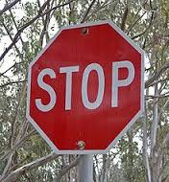


Where do I begin?
Notes:
They are NOT non-readers! This is environmental print.

Slide 9
Research-Based principles
Alphabetics
Fluency
Vocabulary
Comprehension
Notes:
The four main components of reading.
The application of these research-based strategies will increase the likelihood of success in reading instruction.

Slide 10
What is Alphabetics?
“English is an alphabetic language. The letters in its alphabet represent the sounds of spoken English. The process of using the written letters in an alphabet to represent meaningful spoken words is called alphabetics, and includes both phonemic awareness and word analysis.”
(Curtis & Kruidenier, 2005)
Notes:
Phonemic awareness is the knowledge of the basic sounds (phonemes) of spoken language. Word analysis is the knowledge of the connection between written letters or letter combinations and the sounds they represent.
• Must be learned through reading and writing-not just acquired naturally

Slide 11
Why Teach Alphabetics?
“Phonemic awareness and word analysis help learners become familiar with how the English writing system works a crucial step in learning to read. Students with good phonemic awareness know how to manipulate the individual sounds (phonemes) of spoken English. They know, for example, that the spoken word cat is made up of three sounds: /c/-/a/-/t/. ”
(Curtis & Kruidenier, 2005)
Notes:
Adult non-readers have virtually no awareness of phonemes (39), and adult beginning readers have difficulty manipulating phonemes (39). They also have difficulty applying letter-sound knowledge in order to figure out new or unfamiliar words while reading (40). When adult beginning reading instruction includes alphabetics, increases in reading achievement occur (43).

Slide 12
How do I Assess Alphabetics?
“Phonemic awareness is assessed orally through tasks that ask learners to demonstrate their ability to manipulate the sounds in spoken words. The National Reading Panel (NRP, 2000, p. 2-10) provides the following summary of these kinds of tasks.” (Curtis & Kruidenier, 2005)
(See following slides for list)
Notes:
Handout

Slide 13
Assessing Alphabetics
Phoneme isolation: recognizing individual sounds in words, for example, "Tell me the first sound in paste." (/p/)
Phoneme identity: recognizing the common sound in different words, for example, "Tell me the sound that is the same in bike, boy, and bell." (/b/)
Phoneme categorization: recognizing the odd sounding word in a sequence of three or four words, for example, "Which word does not belong? bus, bun, rug." (rug)
(Curtis & Kruidenier, 2005)
Notes:
These are also the strategies that fluent readers use to decode words.

Slide 14
Assessing Alphabetics
Phoneme blending: listening to a sequence of separately spoken sounds and combining them to form a recognizable word. For example, "What word is /s/ /k/ /u/ /1/?" (school)
Phoneme segmentation: breaking a word into its sounds by tapping out or counting the sounds, or by pronouncing and positioning a marker for each sound, for example, "How many sounds are there in ship?" (three: /sh/ /i/ /p/)
Phoneme deletion: recognizing what word remains when a specified phoneme is removed, for example, "What is smile without the /s/?" (mile) (Curtis & Kruidenier, 2005)

Slide 15
Assessing Alphabetics
Word Analysis
  "What sounds do these letters make: b, d, f?"
  "What is the short vowel sound made by these letters: a, e, i?"
  "What sounds do these letters make: ch, ck, oa, ee?"
  "What sounds do these letters make: br, st, str, at, am?” (Curtis & Kruidenier, 2005)

Slide 16
How do I Teach Alphabetics?
Phoneme Blending
Phoneme Segmentation
Syllable-Based Instruction
Word Families
Language Experience Approach (LEA)
Skywriting
  (Ianiro, 2007)
Notes:
Handout

Slide 17
Alphabetics Activity!
Make and Take!
What words do your students need to know to become functionally literate?

Slide 18
Alphabetics: Implications
“Alphabetics can be improved by participation in adult education (42, 43), and explicit instruction may be the best way to accomplish this (45). Explicit instruction consists of direct teaching of letter-sound relationships in a clearly defined sequence.”
(Curtis & Kruidenier, 2005)
Notes:
Not something students do on the side.

Slide 19
What is Fluency?
“Fluency is the ability to read with efficiency and ease. Fluent readers can read quickly and accurately and with appropriate rhythm, intonation, and expression.”
(Curtis & Kruidenier, 2005)
Notes:
Accuracy, Rate, Prosody

Slide 20
Why Teach Fluency?
“Without fluency, readers attend more to decoding than to understanding the meaning of what they are reading. Fluency promotes comprehension. Fluent reading also signals that readers are pausing at appropriate points to make sense of the text. When a reader can reproduce the rhythm intended by the author, he or she can grasp the meaning more easily.”
(Curtis & Kruidenier, 2005)

Slide 21
How do I Assess Fluency?
“Reading fluency can be measured formally with standardized tests, or informally with reading inventories, miscue analyses, pausing indices, or measures of rate. Typically, a student reads aloud while the teacher observes and records reading accuracy and reading rate.”
(Curtis & Kruidenier, 2005)

Slide 22
How Do I Teach Fluency?
Model Fluent Reading
Do Repeated Readings in Class
Teach Sight Words
Shared Reading
Echo Reading
Notes:
Repeated reading is the most effective instructional technique for increasing reading fluency in adults (58-61). In repeated reading, a student reads a passage many times while a teacher provides feedback about rate and accuracy levels, helps with difficult words, and models fluent reading.

Slide 23

A Non-Fluent Reader

Slide 24
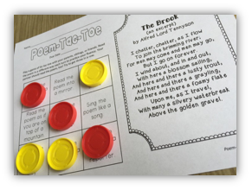
Fluency Activity!
Notes:
Poem Tic Tac Toe

Slide 25
Fluency: Implications
Fluency is important because it provides a bridge between word recognition and comprehension
When fluent readers read silently, they recognize words automatically. They group words quickly to help them gain meaning from what they read
(Curtis & Kruidenier, 2005)
Notes:
If students aren’t fluent, they will be stuck on decoding and they will never fully comprehend text.

Slide 26
What is Vocabulary?
“A person's vocabulary consists of the individual words whose meanings he or she knows and understands. Reading vocabulary comprises those words that we know and understand as we read.”
(Curtis & Kruidenier, 2005)
Notes:
Because reading involves decoding, we can know the meaning of a word when we hear it spoken but still not be able to read it in print. This is common for beginning readers, whose oral vocabulary that is, their speaking and listening vocabulary is often larger than their reading vocabulary.

Slide 27
Why Teach Vocabulary?
“… vocabulary knowledge and skills are crucial for getting meaning from text. Without knowledge of the meanings of the key concepts in a text, a reader will struggle to understand the writer's intended message.”
(Curtis & Kruidenier, 2005)

Slide 28
How do I Assess Vocabulary?
Orally:
  For example, some tasks ask the learner to respond with oral answers: "Tell me what the word travel means." Responses scored as correct could require very little knowledge (to go on vacation) or more depth of knowledge (to move from one place to another).
In Writing:
  Another more common task is the written, multiple-choice question. Multiple-choice items can also be structured to require more, or less, depth of knowledge.
  (Curtis & Kruidenier, 2005)
Notes:
Very little research exists on the assessment of adult basic education students' vocabulary knowledge.
We should not assume that adult students will have well-developed vocabularies just because they are older and more experienced.

Slide 29
How Do I Teach Vocabulary?
“Explicit instruction: students are given definitions or other attributes of words to be learned. An example would be teaching students about the meanings of common roots, prefixes, and suffixes.
Implicit instruction: students are exposed to words or given opportunities to do a great deal of reading. As experiences with words increase, so do opportunities to learn new word meanings.”
  (Curtis & Kruidenier, 2005)

Slide 30
How Do I Teach Vocabulary?
“Multimedia Methods: students learn vocabulary by going beyond text to experience other media such as graphic representations. Semantic mapping, where visual representations are used to illustrate the relationships among new and known word meanings, is an example.”
(Curtis & Kruidenier, 2005)
Notes:
Pictures, semantic maps, realia, electric bills

Slide 31
How Do I Teach Vocabulary?
“Capacity methods: students practice extensively to increase their vocabulary capacity through making reading automatic. For instance, increasing a reader's fluency enables him or her to make better use of the clues in a text that help in learning new word meanings.
Association methods: students learn to draw connections between what they do know and words they encounter that they do not know. Pairing a new word with a known synonym is an example.”
(Curtis & Kruidenier, 2005)

Slide 32
Vocabulary Activity!
Concentration

Slide 33
Vocabulary: Implications
Initial research suggests that the longer adult students remain in effective programs, the more their vocabulary will improve (70, 73).
The more expansive vocabulary is, the greater my understanding in a variety of contexts.
But more research is needed…
(Curtis & Kruidenier, 2005)

Slide 34
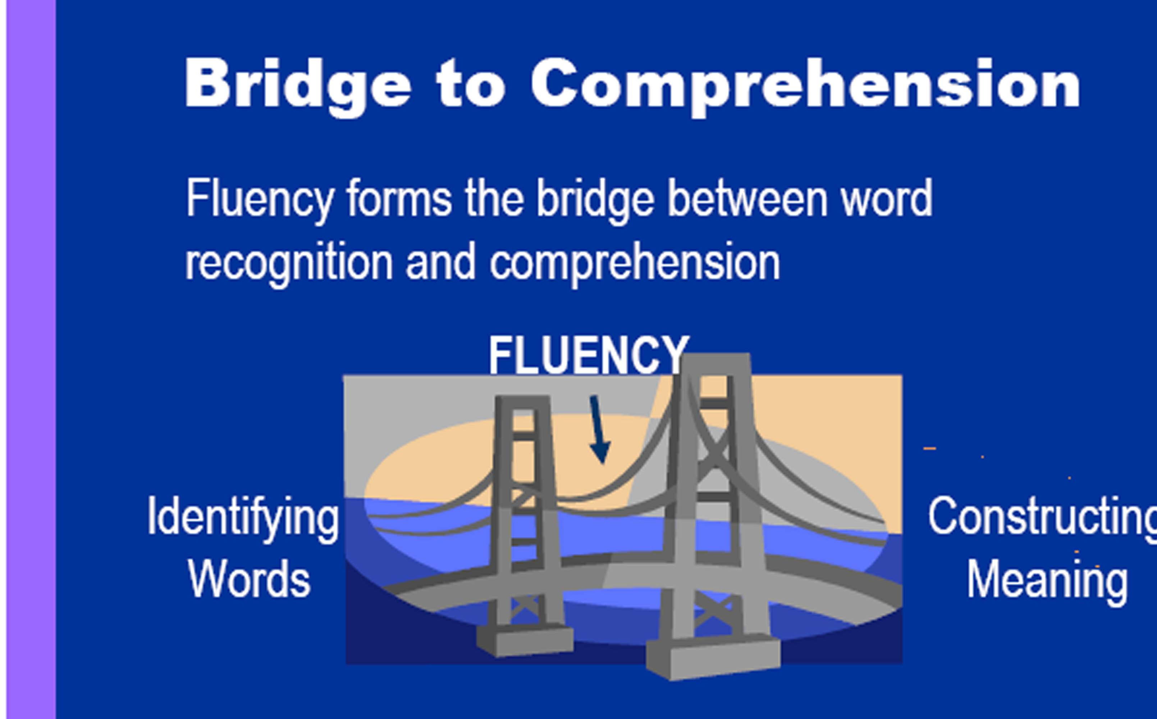
What is Comprehension?
“Reading comprehension is the process of constructing meaning from what is read.”
(Curtis & Kruidenier, 2005)
    Decoding
    Fluency
    Automaticity
    Self-Monitoring
Notes:
Show books

Slide 35
Why Teach Comprehension?
It is the final goal for being a good reader!
“Comprehension is an active process; readers must interact and be engaged with a text. To accomplish this, proficient readers use strategies or conscious plans of action.”
(Curtis & Kruidenier, 2005)
Notes:
Most of our students have learned the art of positivity, meaning they effectively learn how to look busy. The more motivated a student is more he will be engaged, which leads to an increase in comprehension. You are responsibly for making it an active process.

Slide 36
How do I Assess Comprehension?
Ask students to read and answer questions about what they have read:
    Multiple-choice
    Short answer
    Cloze or fill-in-the-blank questions
    Outlines or maps
    Writing prompts
    Observation
    Conferring
Notes:
Adult instructors should choose comprehension tests carefully based on secondary issues.

Slide 37
Focus Strategies To Model/Teach
Predictions
Connections (Text to Self, Text to Text, Text to World)
Clarifications
Questions
Visualizing
Determining Importance
Inferring
Synthesizing
(Harvey & Goodvis, 2000)
Notes:
Article

Slide 38
Other suggestions supported by research include:
“Use adult oriented material, which can be motivating and necessary for decoding instruction (which, in turn, enables comprehension) (91).
Devote sufficient classroom time to reading and writing instruction; one study suggests spending at least 70% of classroom time on reading and writing instruction (92).”
(Curtis & Kruidenier, 2005)

Slide 39
Comprehension Activity!
Article
  Annotate where your stopping points would be to model your thinking
  Annotate which strategies you would model
Notes:
Veteran Article

Slide 40
Comprehension: Implications
“In some adult instructional settings, student comprehension has been improved by manipulating the classroom environment. Some enabling factors in the classroom environment include: emphasizing learner-centered activities (89); and dealing explicitly with adults' motivation and how they feel about their reading (95).”
(Curtis & Kruidenier, 2005)

Slide 41
The End Goal…
People read to learn and understand
Readers interact with a text for comprehension to occur
They understand more when they are familiar with the basic vocabulary or concepts
People are motivated and, at the most basic level, functionally literate
Notes:
presented When a reader does not have adequate prior knowledge and cannot figure out key concepts, comprehension suffers.”

Slide 42
Remember…
“Most educators maintain that effective reading and reading instruction cannot occur without sufficient motivation on the part of the learner. Motivation would seem to be especially important in adult literacy because in addition to an initial desire to learn to read adults must address many barriers to participation, set aside the time necessary to receive effective instruction, and overcome any embarrassment resulting from the stigma associated with seeking help for poor reading skills.”
Notes:
When researchers have looked at motivation, results suggest that dealing with adults literacy beliefs and goals for learning may increase their reading comprehension achievement (95).

Slide 43
Closure
Discuss functional literacy
Define the four research-based principles
Articulate how functional literacy can influence teaching and learning

Slide 45
Questions? Comments?
Stacy A. Griffin, Ed.D.
stacyannegriffin@gmail.com
Wendy A. McWhorter, M.A.
wendyamcwhorter@gmail.com

Slide 46
References
Harvey, S., & Goudvis, A. (2000). Strategies that work: Teaching comprehension to enhance understanding. York, Me: Stenhouse.
Curtis, M. E. & Kruidenier, J. R. (2005). A summary of scientifically based research principles: teaching adults to read. Retrieved from https://lincs.ed.gov/publications/html/teach_adults/teach_adults.html
National Center for Educational Statistics in the United States. "The Health Literacy of America's Adults" (PDF). United States Department of Education. 2006. Retrieved 23 February 2017.

