Slide 1
Classroom Environment
Stacy A. Griffin, Ed.D.
Educational Consultant

Slide 2
Purpose
By the end of this session, participants will be able to articulate how and why to design a classroom environment that promotes optimal student learning.

Slide 3
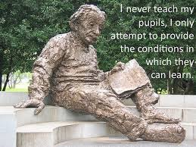
Albert Einstein stated…
Notes:
Image retrieved from https://matnonline.wordpress.com
What does this statement mean to you?

Slide 4
Write-Pair-Share
Reflect on your favorite place (a beach, vacation spot, reading nook, etc.)
What makes this a special place?
Describe the sights, sounds, scents
Discuss the impressions this place leaves on you
Notes:
Did any of you describe an environment that stimulated your senses?
One that is comfortable, safe, or stimulating.

Slide 5
Research
There is a direct correlation between the number of senses activated and the amount of brain activity.
A purposefully designed classroom will lead to increased brain function, which will lead to increased cognition!
Notes:
The environment can stimulate our entire nervous system.
The nervous system consists of the brain, spinal cord, sensory organs, and all of the nerves that connect these organs with the rest of the body. Together, these organs are responsible for the control of the body and communication among its parts.
Your classroom environment has a direct correlation with student processing and learning.

Slide 6
Draw Your Room
Complete a sketch of your classroom environment
Discuss what works well and what you would like to change
We will return to this activity later
Notes:
Now that you have designed your current learning environment - Let’s discuss ways to optimize student learning in the classroom.
We will revisit your digital layouts later.

Slide 7
A Positive Classroom Environment
Environment Video
This video previously contained a copyrighted audio track. Due to a claim by a copyright holder, the audio track has been muted.

Slide 8
Classroom Layout
To create a classroom where optimal learning can take place, you must consider physical layout.
Examples:
  Seating
  Bulleting boards
  Rug area
  Classroom Library
  Storage

Slide 9
Essential Topics
Teacher’s Desk
Student Seating
Rug Area
Kidney Table
Classroom Library

Slide 10
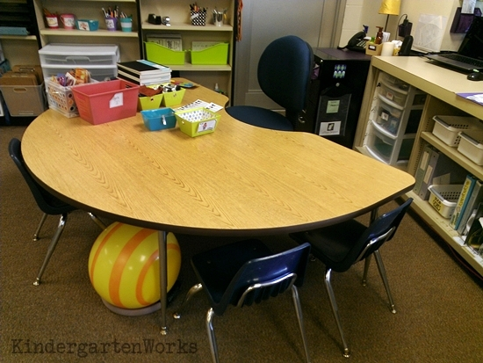
Lose the Teacher’s Desk
If you are sitting at it, you are not teaching
It collects clutter
There are alternative places for your teaching tools
It saves space

Slide 11
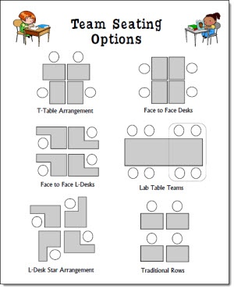
Student Seating
NO

Slide 12
Informal Seating
Myth: Children learn best when sitting up straight in hard chairs
Reality: Approximately 75% of our body weight is only supported by four square inches on bone when sitting up straight in a hard chair
Results: Stress on tissue ➔ Fatigue, Discomfort, Restlessness
Notes:
Research supports the idea that many students pay better attention and achieve higher grades when seated in more comfortable positions.

Slide 13

Rug Area

Slide 14
Space
Old School: Students learn best when sitting quietly and still
New School: Students need extensive mobility while learning, and discussion increases cognition
Notes:
Children learn significantly more when they move from one area to another to acquire new information

Slide 15

Kidney Table

Slide 16
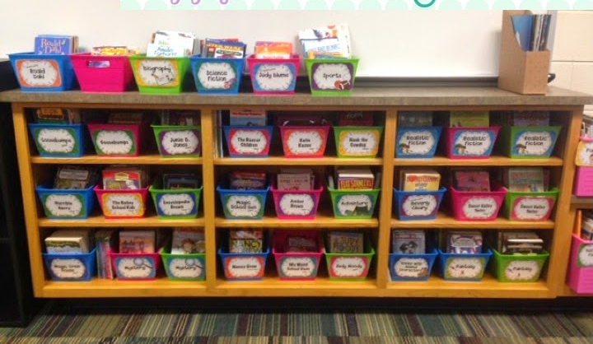
Classroom Library

Slide 17
Chat and Chart
Classroom Walls
Word Walls
Technology

Slide 18
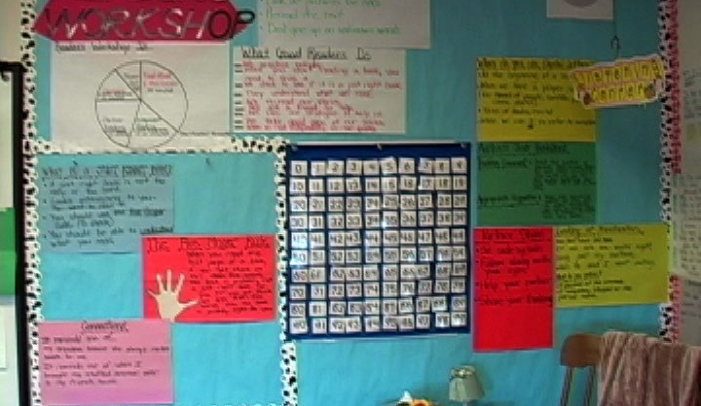
Classroom Walls

Slide 19
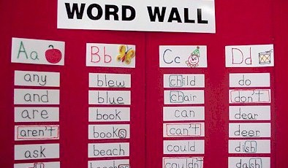
Word Walls

Slide 20
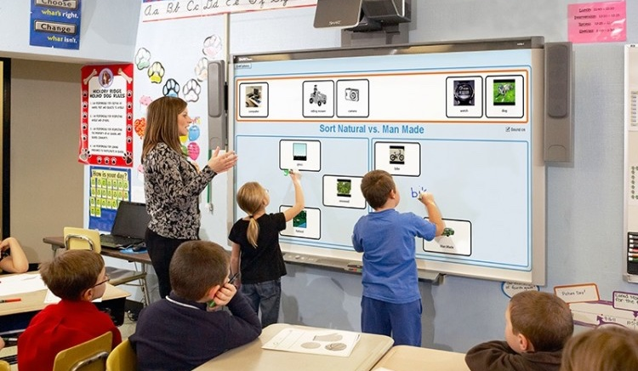
Technology

Slide 21
Storage
  Class Supplies
  Student Belongings
  Teacher Belongings

Slide 22
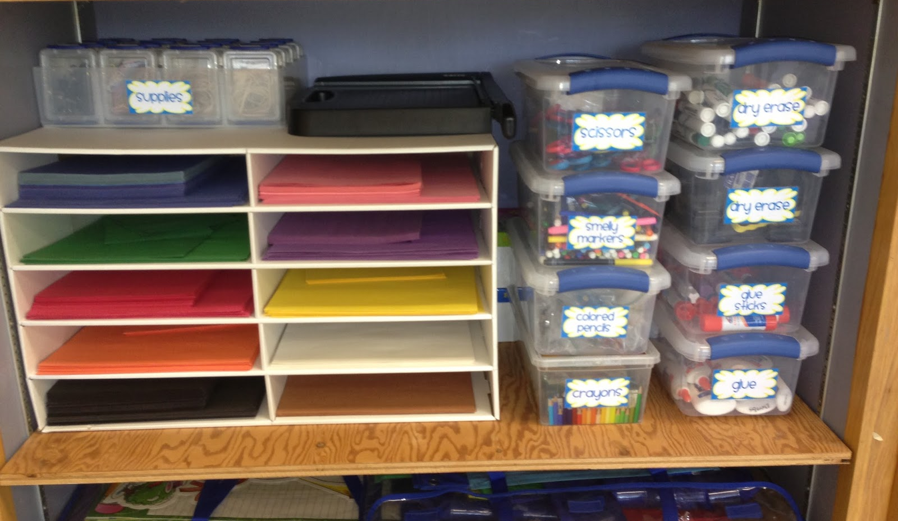
Class Supplies

Slide 23

Student Belongings

Slide 24
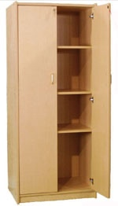
Teacher Belongings

Slide 25
Classroom Layout
To create a classroom where optimal learning can take place, you must also consider environmental features.
Examples:
  Temperature
  Lighting
  Internal Noise Level
  External Noise Level
Notes:
These factors affect students differently can affect individual learning styles.
Studies show that when environmental features meet students’ preferences, they are more likely to perform better socially and academically.
Help students learn how to dress accordingly.
Be empathetic – it is difficult to focus when you are too cold or too hot.

Slide 26
Temperature
Help students learn how to become aware of temperature preferences
Help students learn how to dress accordingly
Be empathetic – it is difficult to focus when you are too cold or too hot

Slide 27
Lighting
Create well lit areas in the classroom
Create areas that can become more dimly lit using:
  Bookcases
  Plants
  Furniture
  Etc.
Notes:
Some students work best in bright light, while others excel in low light.
Bright light can lead to hyperactivity in some students.
If possible, seat your most energetic students in low light and your least energetic in brighter areas.

Slide 28
The Sound of Silence
Myth: ALL students learn better in a silent environment
Reality: Some students are actually more productive with a bit of background noise
Results:
  Establish listening centers or small areas where soft music can be played
  Establish quiet areas for those who work best in silence
Notes:
How do we know what our students are thinking if we can’t hear them verbalize their thoughts?

Slide 29
Revisiting Your Sketch
Look at the original sketch you made of your classroom environment
Make modifications or create a new sketch for optimal learning environments based on what you learned today
Notes:
Compare your classroom to your new classroom design
Have you made any changes? Why or why not?

Slide 30
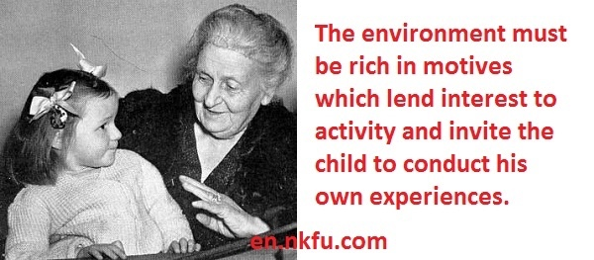
Classroom Environment
Notes:
Maria Montessori

Slide 31
Closure
Articulate how and why you should design a classroom environment that promotes optimal student learning.

Slide 32
Wrap Up
Questions?
Comments
Evaluations
Thank you!
Stacy A. Griffin, Ed.D.
Educational Consultant
Little Lake City School District

Slide 33
Contact
Please contact the consultant for a list of references.

